Slide 1
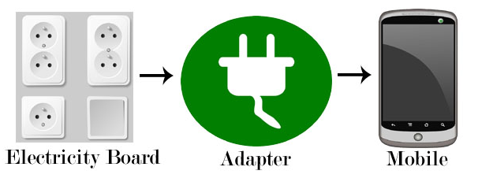
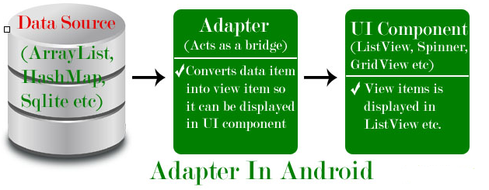
Adapter
Adapter is a bridge between UI component and data source that helps us to fill data in UI component.
It holds the data and send the data to an Adapter view then view can takes the data from the adapter view and shows the data on different views like as ListView, GridView, Spinner etc.
To fill data in a list or a grid we need to implement Adapter.
Here data source is the source from where we get the data and UI components are list or grid items in which we want to display that data.

Slide 2
Adapter
Adapters In Android:
There are the some commonly used Adapter in Android used to fill the data in the UI components:
BaseAdapter – It is parent adapter for all other adapters
ArrayAdapter – It is used whenever we have a list of single items which is backed by an array
Custom ArrayAdapter – It is used whenever we need to display a custom list
SimpleAdapter – It is an easy adapter to map static data to views defined in your XML file
Custom SimpleAdapter – It is used whenever we need to display a customized list and needed to access the child items of the list or grid
Note :
ArrayAdapter is more simple and commonly used Adapter in android.
Whenever you have a list of single type of items like an array, we use ArrayAdapter. Ex. List of phone contacts, countries or names.

Slide 3
ListView
List of scrollable items can be displayed in Android using ListView.
Users can then select any list item by clicking on it.
ListView is default scrollable
A very common example of ListView is your phone contact book, where you have a list of your contacts displayed in a ListView and if you click on it then user information is displayed.

Slide 4
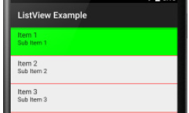
ListView
Attributes of ListView:
id: id is used to uniquely identify a ListView.
divider: This is a drawable or color to draw between different list items.
dividerHeight: This specify the height of the divider between list items.
listSelector: listSelector property is used to set the selector of the listView. It is generally orange or Sky blue color mostly but you can also define your custom color or an image as a list selector as per your design.
<ListView
android:id="@+id/simpleListView"
android:layout_width=“match_parent"
android:layout_height="wrap_content"
android:divider="#f00"
android:dividerHeight="1dp"
android:listSelector="#0f0"/> <!--list selector in green color-->

Slide 5
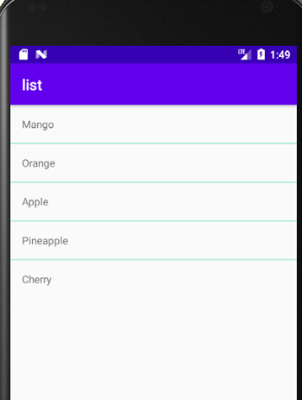

Slide 6
ListView
<LinearLayout xmlns:android="http://schemas.android.com/apk/res/android"
android:layout_width="match_parent"
android:layout_height="match_parent"
android:orientation="vertical">
<ListView
android:id="@+id/simpleListView"
android:layout_width="wrap_content"
android:layout_height="wrap_content"
android:divider="@color/material_blue_grey_800"
android:dividerHeight="1dp" />
</LinearLayout>

Slide 7
ListView
activity_listview.xml
<?xml version="1.0" encoding="utf-8"?>
<LinearLayout xmlns:android="http://schemas.android.com/apk/res/android"
android:layout_width="match_parent"
android:layout_height="match_parent"
android:orientation="vertical">
<TextView
android:id="@+id/textView"
android:layout_width="match_parent"
android:layout_height="wrap_content"
android:layout_gravity="center"
android:padding="16dp"
android:textColor="@color/black" />
</LinearLayout>

Slide 8
ListView
mainActivity.java
public class MainActivity extends AppCompatActivity {
// Array of strings...
ListView simpleList;
String countryList[] = {"India", "China", "australia", "Portugle", "America", "NewZealand"};
@Override protected void onCreate(Bundle savedInstanceState) {
super.onCreate(savedInstanceState); setContentView(R.layout.activity_main);
simpleList = (ListView)findViewById(R.id.simpleListView);
ArrayAdapter<String> arrayAdapter = new ArrayAdapter<String>(this, R.layout.activity_listview, R.id.textView, countryList);
simpleList.setAdapter(arrayAdapter);
}
}

Slide 9
ListView
mainActivity.java
simpleList.setOnItemClickListener(new AdapterView.OnItemClickListener() {
@Override
public void onItemClick(AdapterView<?> parent, View view, int position, long id) {
String value = arrayAdapter.getItem(position);
Toast.makeText(getApplicationContext(),value,Toast.LENGTH_SHORT).show();
}
});
}
}

Slide 10
Custom ListView
BaseAdapter is a common base class of a general implementation of an Adapter that can be used in ListView.
Whenever you need a customized list you create your own adapter and extend base adapter in that.
Base Adapter can be extended to create a custom Adapter for displaying a custom list item.
ArrayAdapter is also an implementation of BaseAdapter.

Slide 11
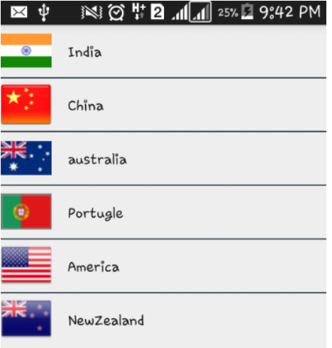
ListView – Custom Adapter

Slide 12
<?xml version="1.0" encoding="utf-8"?>
<LinearLayout xmlns:android="http://schemas.android.com/apk/res/android"
xmlns:app="http://schemas.android.com/apk/res-auto"
xmlns:tools="http://schemas.android.com/tools"
android:layout_width="match_parent"
android:layout_height="match_parent"
tools:context=".MainActivity">
<ListView
android:layout_width="wrap_content"
android:layout_height="wrap_content"
android:id="@+id/simpleView"
android:divider="@color/colorPrimary"
android:dividerHeight="1dp"/>
</LinearLayout>

Slide 13
activity_listview.xml
<?xml version="1.0" encoding="utf-8"?>
<LinearLayout xmlns:android="http://schemas.android.com/apk/res/android"
android:layout_width="match_parent"
android:layout_height="match_parent"
android:orientation="horizontal">
<ImageView
android:id="@+id/icon"
android:layout_width="50dp"
android:layout_height="50dp"
/>
<TextView
android:id="@+id/textView"
android:layout_width="match_parent"
android:layout_height="wrap_content"
android:layout_gravity="center"
android:padding="15dp"
android:textColor="#FF9800" />
</LinearLayout>

Slide 14
import androidx.appcompat.app.AppCompatActivity;
import android.os.Bundle;
import android.widget.ListView;
public class MainActivity extends AppCompatActivity {
ListView simpleList;
String countryList[] = {"India", "Australia", "America"};
int flags[] = {R.drawable.india, R.drawable.australia, R.drawable.america};
@Override
protected void onCreate(Bundle savedInstanceState) {
super.onCreate(savedInstanceState);
setContentView(R.layout.activity_main);
simpleList = findViewById(R.id.simpleView);
CustomAdapter customAdapter = new CustomAdapter(getApplicationContext(), countryList, flags);
simpleList.setAdapter(customAdapter);
}
}

Slide 15
CustomAdapter.java
package com.sindhu.customlist;
import android.content.Context;
import android.view.LayoutInflater;
import android.view.View;
import android.view.ViewGroup;
import android.widget.BaseAdapter;
import android.widget.ImageView;
import android.widget.TextView;
public class CustomAdapter extends BaseAdapter {
Context context;
String CountryList[];
int flags[];
LayoutInflater inflter;
public CustomAdapter(Context context, String[] countryList, int[] flags) {
this.context = context;
CountryList = countryList;
this.flags = flags;
this.inflter = (LayoutInflater.from(context)); // Create a new LayoutInflater instance associated with a particular Context
}

Slide 16
CustomAdapter.java
@Override
public int getCount() {
return CountryList.length;
}
@Override
public Object getItem(int position) {
return null;
}
@Override
public long getItemId(int position) {
return 0;
}

Slide 17
@Override
///Get a View that displays the data at the specified position in the data set. You can either create a View manually or inflate it from an XML layout file.
public View getView(int position, View view, ViewGroup parent) {
view = inflter.inflate(R.layout.activity_listview,null);
TextView country = view.findViewById(R.id.textView);
ImageView icon = view.findViewById(R.id.icon);
country.setText(CountryList[position]);
icon.setImageResource(flags[position]);
return view;
}
}
Note : The LayoutInflater(inflter in example above) will be used to create a row from the XML file. It inflates an XML layout and attaches it to the ListView.

Slide 18
public class CustomAdapter extends BaseAdapter {
@Override
public int getCount() {
return 0;
}
@Override
public Object getItem(int i) {
return null;
}
@Override
public long getItemId(int i) {
return 0;
}
@Override
public View getView(int i, View view, ViewGroup viewGroup) {
return null;
}

Slide 19
In the above code snippet we see the overrided methods of BaseAdapter which are used to set the data in a list, grid or a spinner.
1. getCount():
The getCount() function returns the total number of items to be displayed in a list. It counts the value from array list size() method or an array’s length.
2. getView(int i, View view, ViewGroup viewGroup):
This function is automatically called when the list item view is ready to be displayed or about to be displayed. In this function we set the layout for list items using LayoutInflater class and then add the data to the views like ImageView, TextView etc.

Slide 20
In the above code snippet we see the overrided methods of BaseAdapter which are used to set the data in a list, grid or a spinner.
3. getItem(int i):
This function is used to Get the data item associated with the specified position in the data set to obtain the corresponding data of the specific location in the collection of data items.
4. getItemId(int i):
As for the getItemId (int position), it returns the corresponding to the position item ID. The function returns a long value of item position to the adapter.

Slide 21
Layout Inflater
A LayoutInflater is one of the Android System Services that is responsible for taking your XML files that define a layout, and converting them into View objects.
The OS then uses these view objects to draw the screen.
Typically, you don't ever need to directly use a LayoutInflater.
Android does most of the layout inflation for you when you call setContentView() in the onCreate() method of your activity.
So you, as the programmer, are responsible for making sure the views are inflated.
Now you want to inflate views in the context of a ListView.
The Adapter class can do the inflation for you if you do not want to customize each item.
But if you want to customize the views shown in a list, you will have to manually inflate each view with the LayoutInflater.

Slide 22
Additional Exercise – Custom Listview
Toast message in Custom listview
simpleList.setOnItemClickListener(new AdapterView.OnItemClickListener() {
@Override
public void onItemClick(AdapterView<?> parent, View view, int position, long id) {
// set an Intent to Another Activity
Toast.makeText(getApplicationContext(),countryList[position],Toast.LENGTH_LONG).show();
}
});

Slide 23
Additional Exercise – Custom Listview
Intents
simpleList.setOnItemClickListener(new AdapterView.OnItemClickListener() {
@Override
public void onItemClick(AdapterView<?> parent, View view, int position, long id) {
// set an Intent to Another Activity
Intent intent = new Intent(MainActivity.this, SecondActivity.class);
intent.putExtra("image", flags[position]);
startActivity(intent); // start Intent
}
});
}

Slide 24
Intents in CustomListview
SecondActivity.class
package com.sindhu.customlist;
import android.content.Intent;
import android.os.Bundle;
import androidx.appcompat.app.AppCompatActivity;
import android.widget.ImageView;
public class SecondActivity extends AppCompatActivity {
ImageView selectedImage;
@Override
protected void onCreate(Bundle savedInstanceState) {
super.onCreate(savedInstanceState);
setContentView(R.layout.activity_second);
selectedImage = (ImageView) findViewById(R.id.icon); // init a ImageView
Intent intent = getIntent(); // get Intent which we set from Previous Activity
selectedImage.setImageResource(intent.getIntExtra("image", 0)); // get image from Intent and set it in ImageView
}
}

Slide 25
Intents in CustomListview
activity_second.xml
<?xml version="1.0" encoding="utf-8"?>
<LinearLayout xmlns:android="http://schemas.android.com/apk/res/android"
android:layout_width="match_parent"
android:layout_height="match_parent"
android:orientation="horizontal">
<ImageView
android:id="@+id/icon"
android:layout_width="50dp"
android:layout_height="50dp"
/>
</LinearLayout>

Slide 26
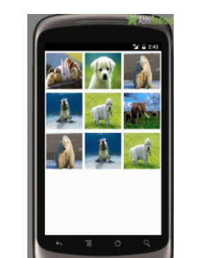
GridView
In android GridView is a view group that display items in two dimensional scrolling grid (rows and columns)
GridView is widely used in android applications. An example of GridView is your default Gallery, where you have number of images displayed using grid.

Slide 27
BaseAdapter for displaying Animal images in grids using Gridview
<?xml version="1.0" encoding="utf-8"?>
<LinearLayout xmlns:android="http://schemas.android.com/apk/res/android"
android:layout_width="match_parent"
android:layout_height="match_parent"
android:orientation="vertical">
<GridView
android:id="@+id/simpleGridView"
android:layout_width=“match_parent"
android:layout_height="wrap_content"
android:numColumns="3" />
</LinearLayout>

Slide 28
BaseAdapter for displaying Animal images in grids using Gridview
Create a new Activity activity_gridview.xml inside layout and add the below code:
<?xml version="1.0" encoding="utf-8"?>
<LinearLayout xmlns:android="http://schemas.android.com/apk/res/android"
android:layout_width="match_parent"
android:layout_height="match_parent"
android:orientation="vertical">
<ImageView
android:id="@+id/icon"
android:layout_width="100dp"
android:layout_height="100dp"
android:scaleType="fitXY"
android:layout_margin="5dp"
android:layout_gravity="center_horizontal" />
</LinearLayout>

Slide 29
BaseAdapter for displaying Animal images in grids using Gridview
import android.app.Activity;
import android.os.Bundle;
import android.widget.GridView;
public class MainActivity extends Activity {
GridView simpleGrid;
int animals[] = {R.drawable.animal13, R.drawable.animal14, R.drawable.animal15, R.drawable.animal16, R.drawable.animal17, R.drawable.animal18, R.drawable.animal15, R.drawable.animal16, R.drawable.animal17};
@Override
protected void onCreate(Bundle savedInstanceState) {
super.onCreate(savedInstanceState);
setContentView(R.layout.activity_main);
simpleGrid = (GridView) findViewById(R.id.simpleGridView);
CustomAdapter customAdapter = new CustomAdapter(getApplicationContext(), animals);
simpleGrid.setAdapter(customAdapter);
}
}

Slide 30
BaseAdapter for displaying Animal images in grids using Gridview
import android.content.Context;
import android.view.LayoutInflater;
import android.view.View;
import android.view.ViewGroup;
import android.widget.BaseAdapter;
import android.widget.ImageView;
public class CustomAdapter extends BaseAdapter {
Context context;
int animals[];
LayoutInflater inflter;
public CustomAdapter(Context applicationContext, int[] animals) {
this.context = applicationContext;
this.animals = animals;
inflter = (LayoutInflater.from(applicationContext));
}

Slide 31
BaseAdapter for displaying Animal images in grids using Gridview
@Override
public int getCount() {
return animals.length;
}
@Override
public Object getItem(int i) {
return null;
}
@Override
public long getItemId(int i) {
return 0;
}

Slide 32
BaseAdapter for displaying Animal images in grids using Gridview
@Override
public View getView(int i, View view, ViewGroup viewGroup) {
view = inflter.inflate(R.layout.activity_gridview, null);
ImageView icon = (ImageView) view.findViewById(R.id.icon);
icon.setImageResource(animals[i]);
return view;
}
}

